Slide 1
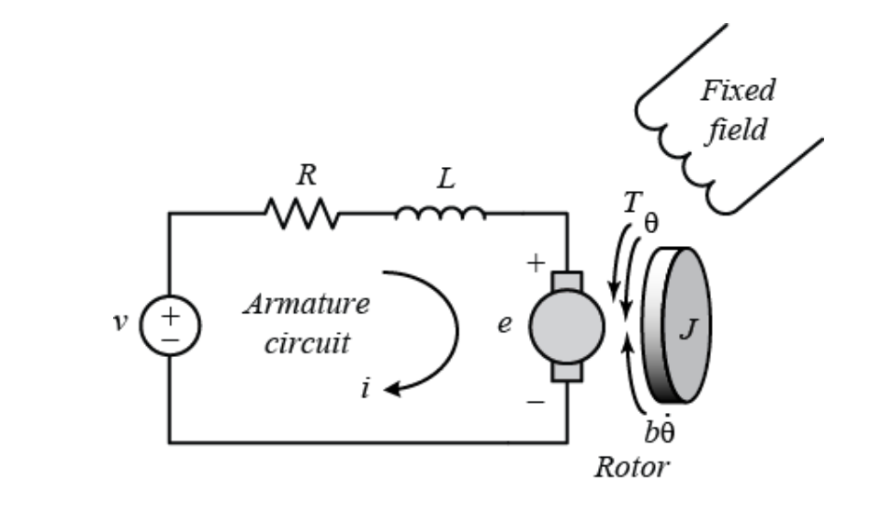
DEVELOP A DC MOTOR MODEL
The electric circuit of the stator and the free-body diagram of the rotor are as shown
http://ctms.engin.umich.edu/CTMS/index.php?example=MotorPosition&section=SimulinkModeling

Slide 2
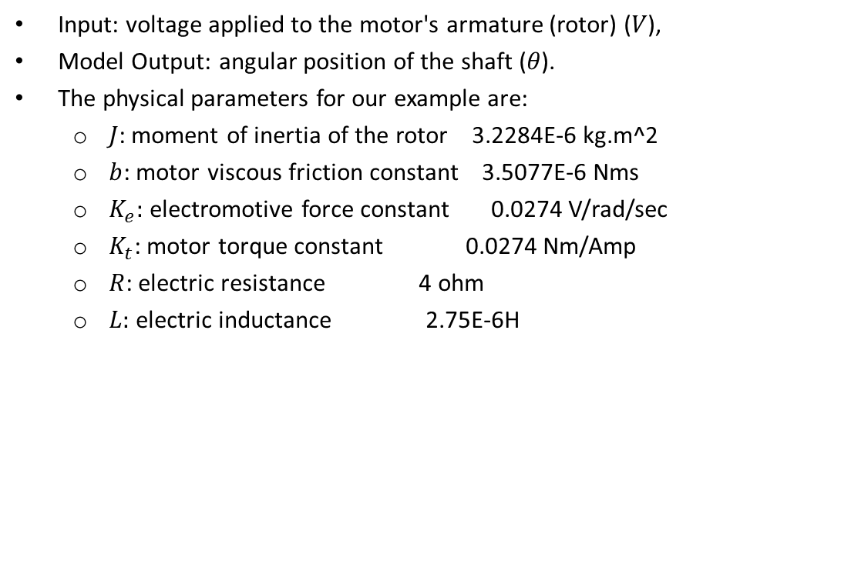
DEVELOP A DC MOTOR MODEL
Input: voltage applied to the motor's armature (rotor) ($V$),
Model Output: angular position of the shaft ($θ$).
The physical parameters for our example are:
$J$: moment of inertia of the rotor 3.2284E-6 kg.m^2
$b$: motor viscous friction constant 3.5077E-6 Nms
$K_{e}:$ electromotive force constant 0.0274 V/rad/sec
$K_{t}$: motor torque constant 0.0274 Nm/Amp
$R$: electric resistance 4 ohm
$L:$ electric inductance 2.75E-6H
http://ctms.engin.umich.edu/CTMS/index.php?example=MotorPosition&section=SimulinkModeling

Slide 3

DEVELOP A DC MOTOR MODEL
The motor torque is proportional to the armature current $i$ by a constant factor $K_{T}$ as shown in the relation below.
$$T = K_{T} i$$
The back emf is proportional to the angular velocity of the shaft by a constant factor as follows:
e = $K_{b}\dot{θ}$
http://ctms.engin.umich.edu/CTMS/index.php?example=MotorPosition&section=SimulinkModeling

Slide 4
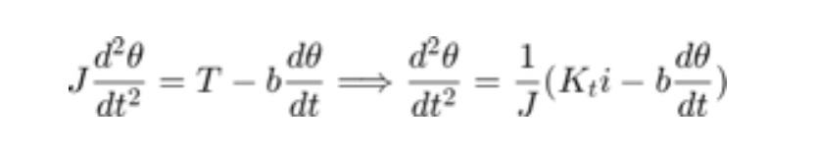
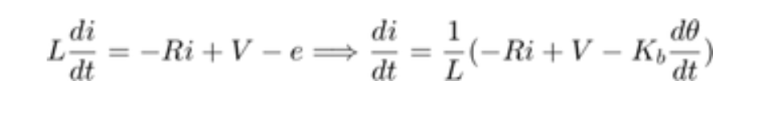
DEVELOP A DC MOTOR MODEL
Applying Newton’s second law:.
Applying Kirchhoff's law:
http://ctms.engin.umich.edu/CTMS/index.php?example=MotorPosition&section=SimulinkModeling

